Slide 1
Isoparametric foliations on complex projective spaces
Differential Geometry Days
In honour of Luis A. Cordero
Miguel Domínguez Vázquez
Department of Geometry and Topology
University of Santiago de Compostela

Slide 2
Contents

Slide 3
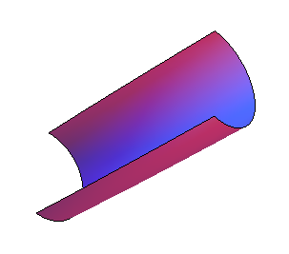
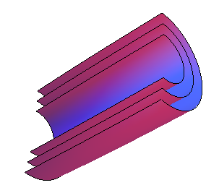
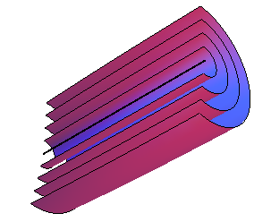
Isoparametric hypersurfaces
Isoparametric and homogeneous
hypersurfaces

Slide 4
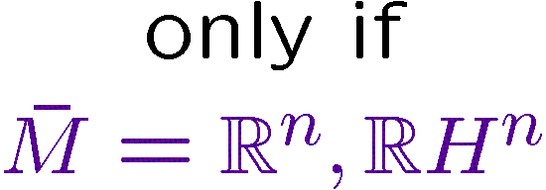
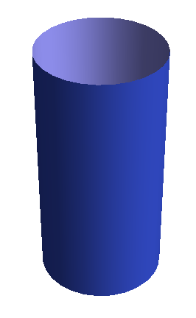
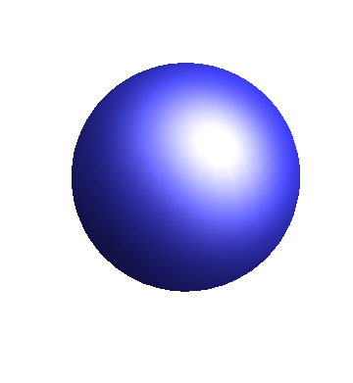
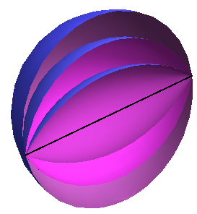
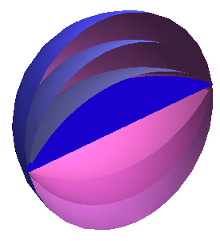
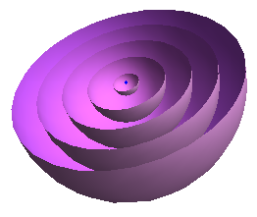
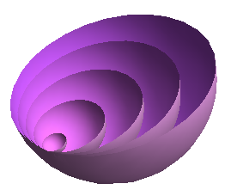
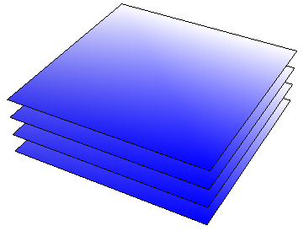
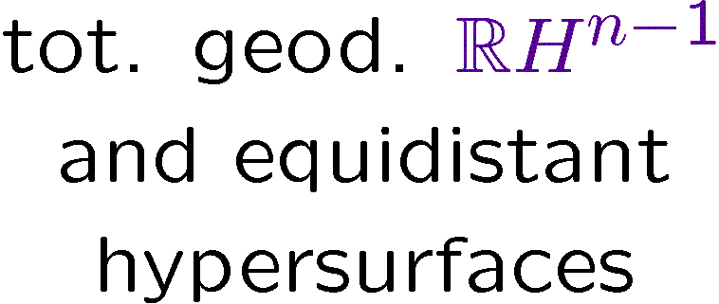
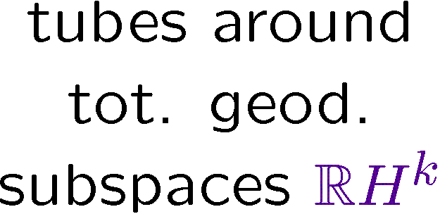
Isoparametric hypersurfaces
The classification in space forms

Slide 5
Isoparametric hypersurfaces
The classification in space forms

Slide 6
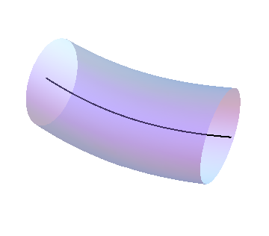
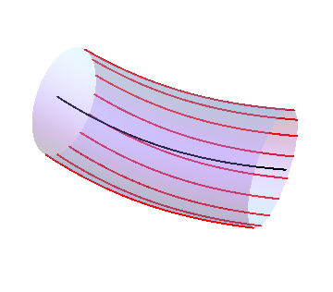
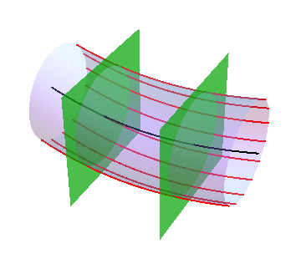
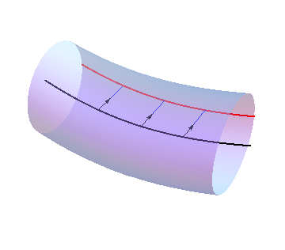
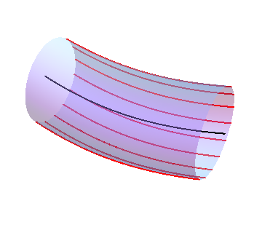
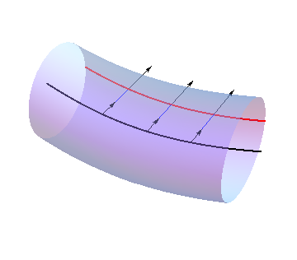
Isoparametric submanifolds
Definition and the problem in real space forms

Slide 7
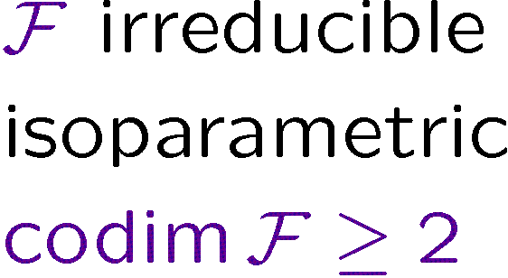
Isoparametric submanifolds
Definition and the problem in real space forms

Slide 8
Isoparametric foliations on CP^{n}
The idea

Slide 9
Isoparametric foliations on CP^{n}
The idea
?
NO
…
≈
/
≈
/

Slide 10
Isoparametric foliations on CP^{n}
Complex structures preserving a foliation

Slide 11
Isoparametric foliations on CP^{n}
Complex structures preserving a foliation

Slide 12
Isoparametric foliations on CP^{n}
Complex structures preserving a foliation

Slide 13
Isoparametric foliations on CP^{n}
Congruence of projected foliations
~
~
~

Slide 14
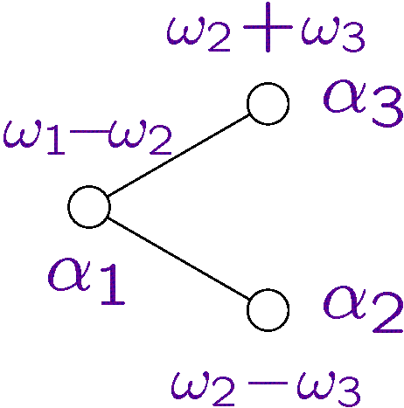
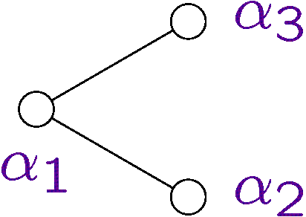
Isoparametric foliations on CP^{n}
Lowest weight diagrams and extended Vogan diagrams

Slide 15
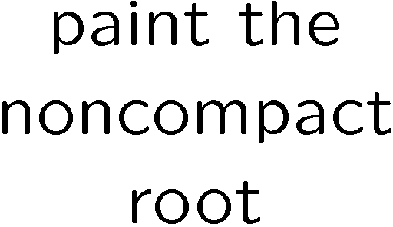
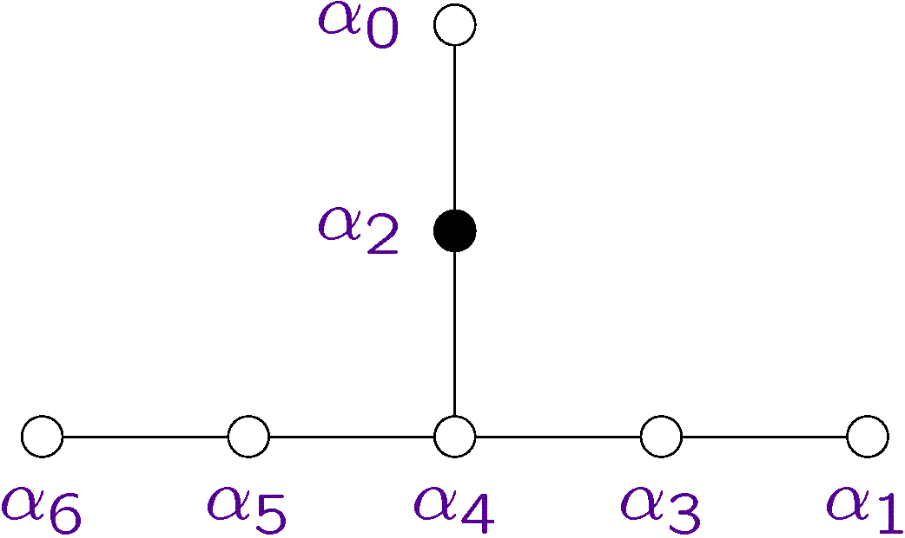
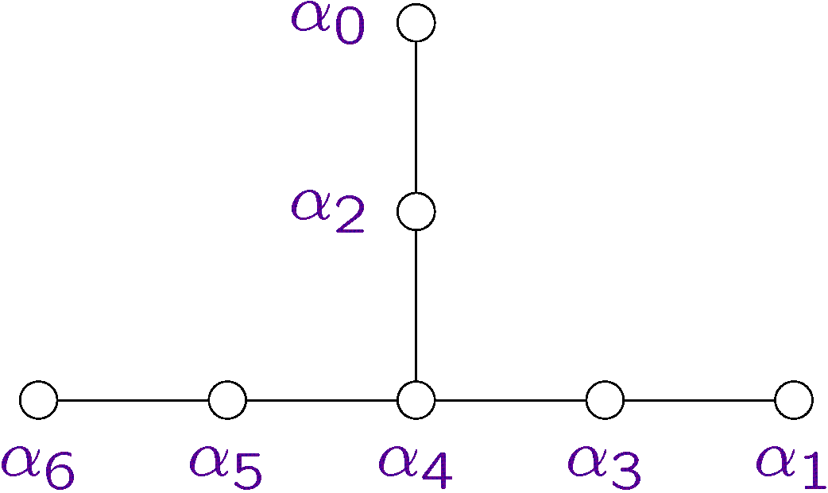
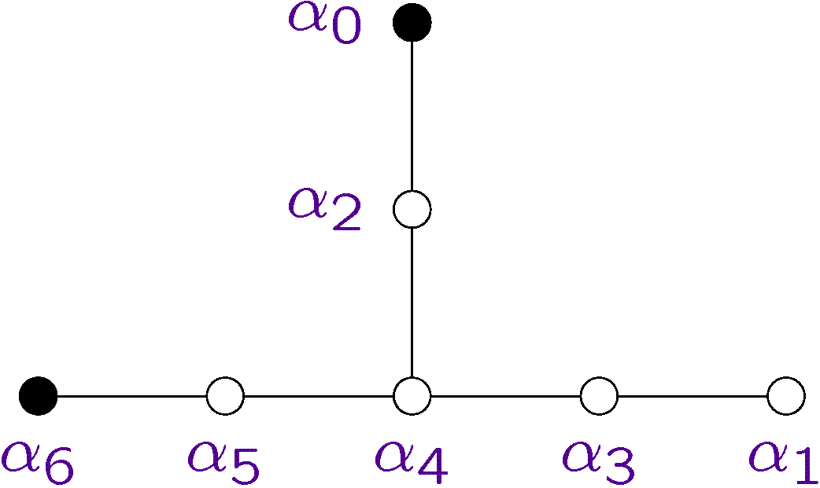
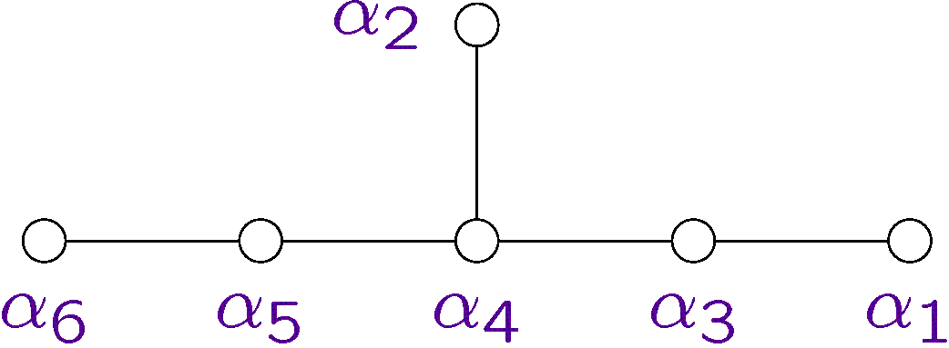
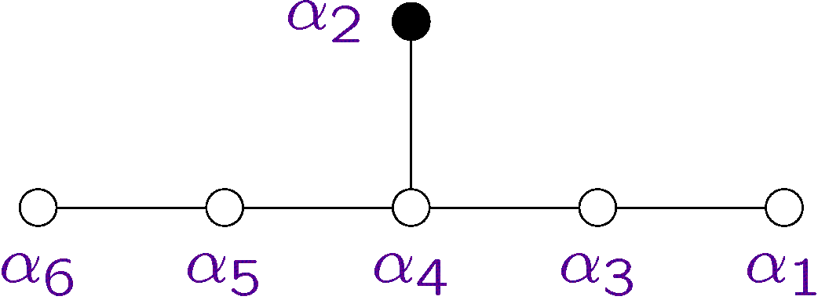
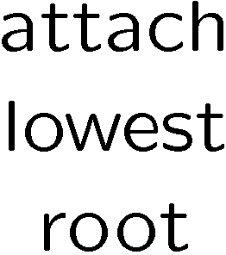
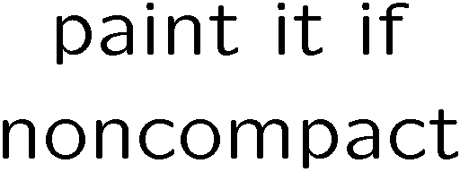
Isoparametric foliations on CP^{n}
Lowest weight diagrams and extended Vogan diagrams

Slide 16
Isoparametric foliations on CP^{n}
Criterion for homogeneity.
Inhomogeneous examples
?

Slide 17
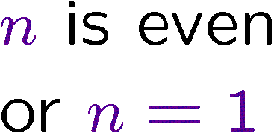
Isoparametric foliations on CP^{n}
Criterion for homogeneity.
Inhomogeneous examples
?

Slide 18
Thanks!

Slide 19
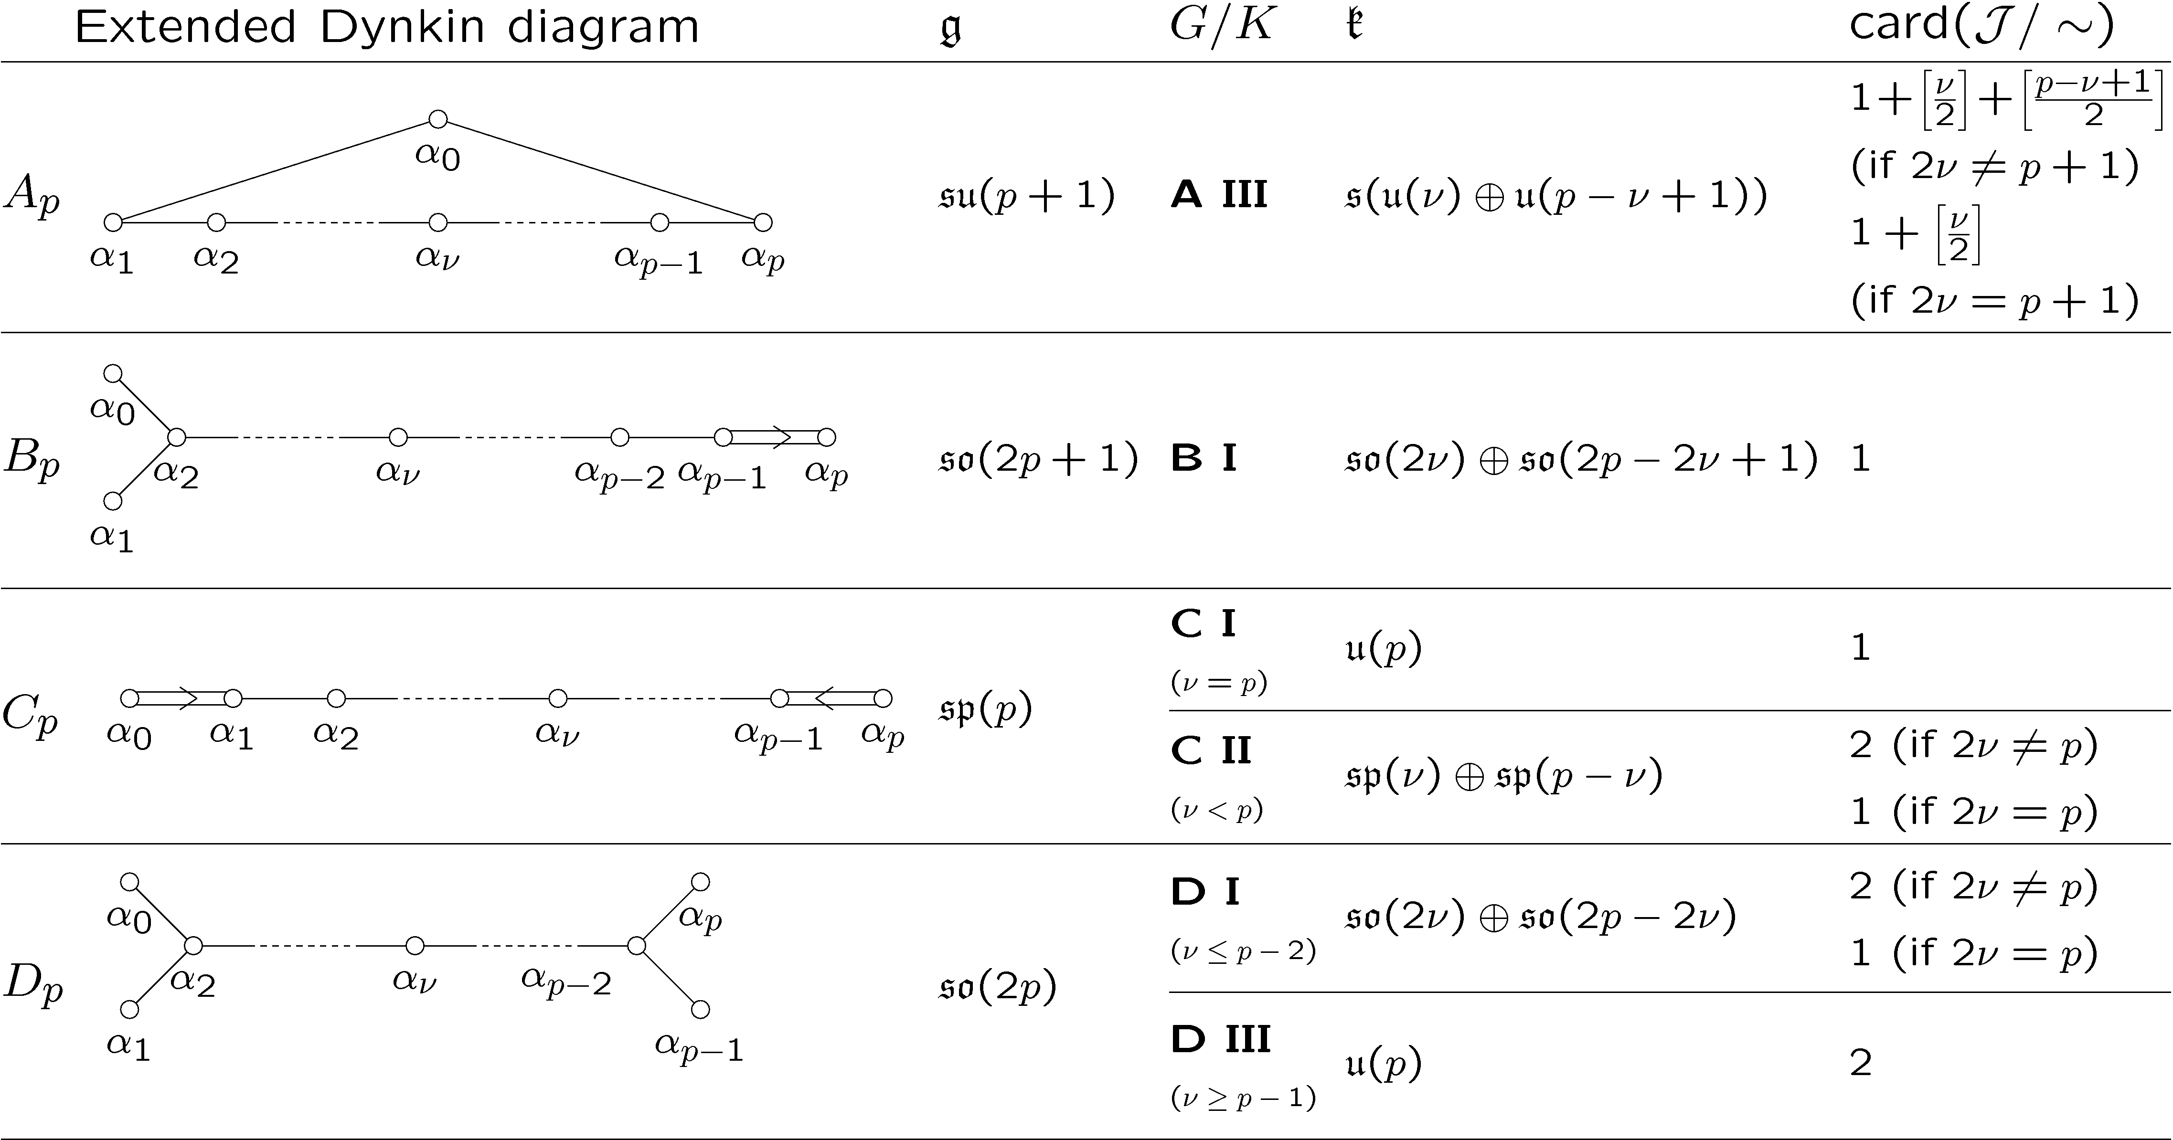
Isoparametric foliations on CP^{n}
Classification: projections of homogeneous polar foliations I

Slide 20
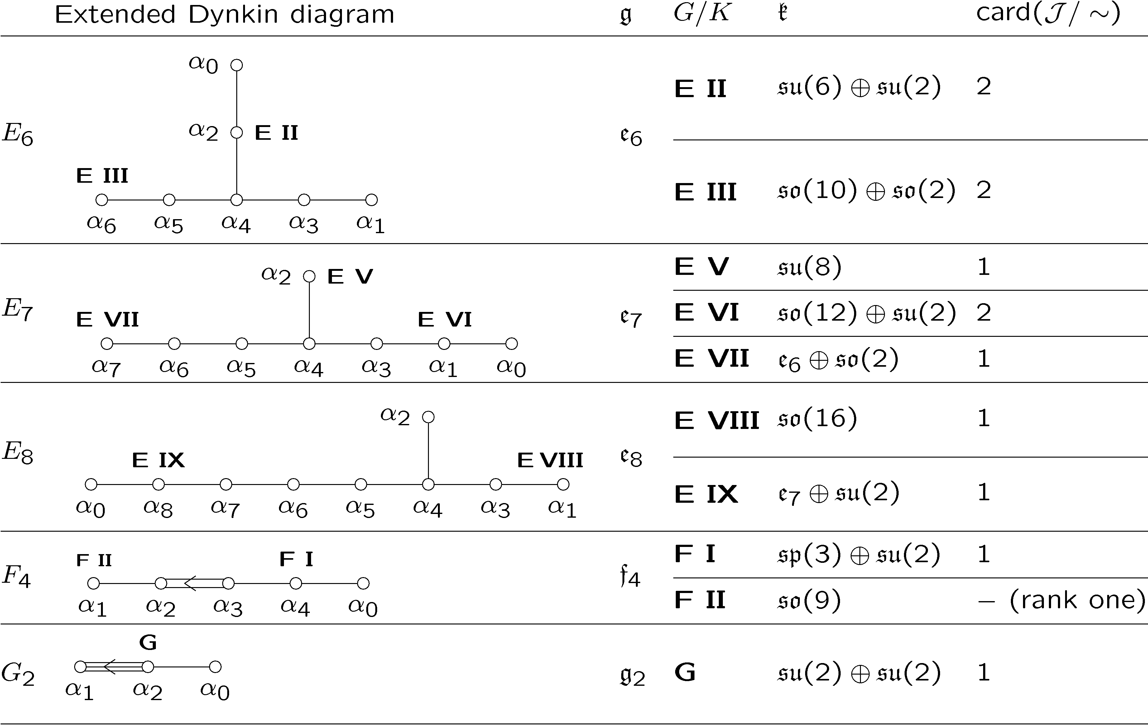
Isoparametric foliations on CP^{n}
Classification: projections of homogeneous polar foliations II

Slide 21
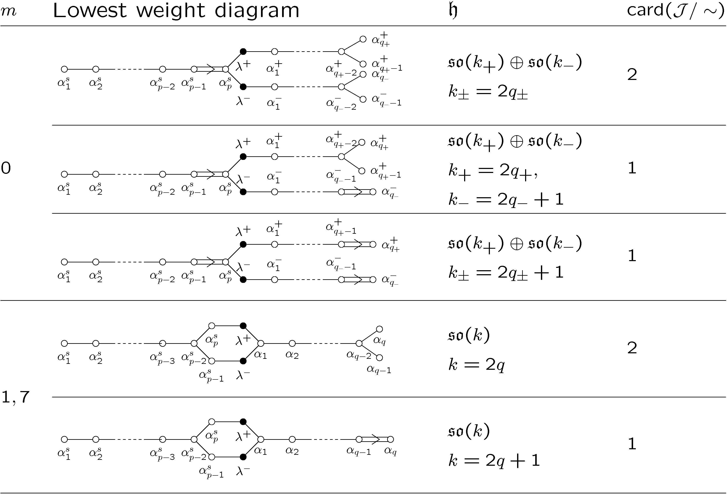
Isoparametric foliations on CP^{n}
Classification: projections of FKM-foliations I

Slide 22
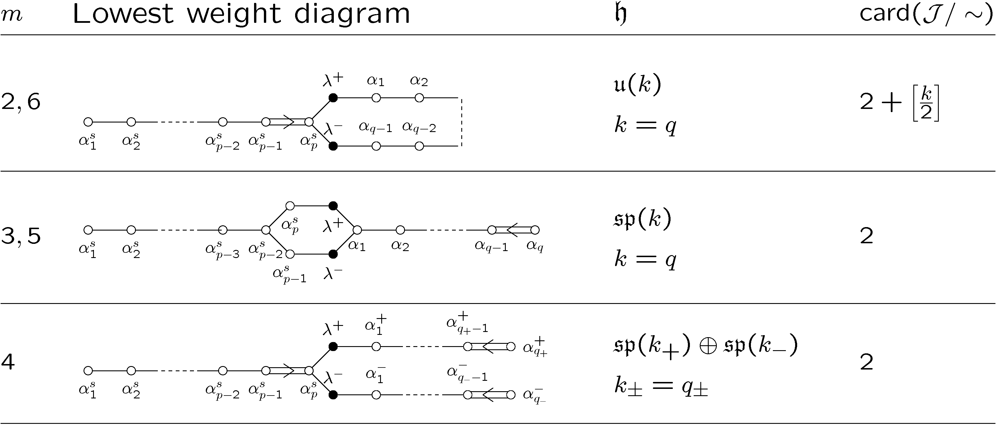
Isoparametric foliations on CP^{n}
Classification: projections of FKM-foliations II

